Slide 1
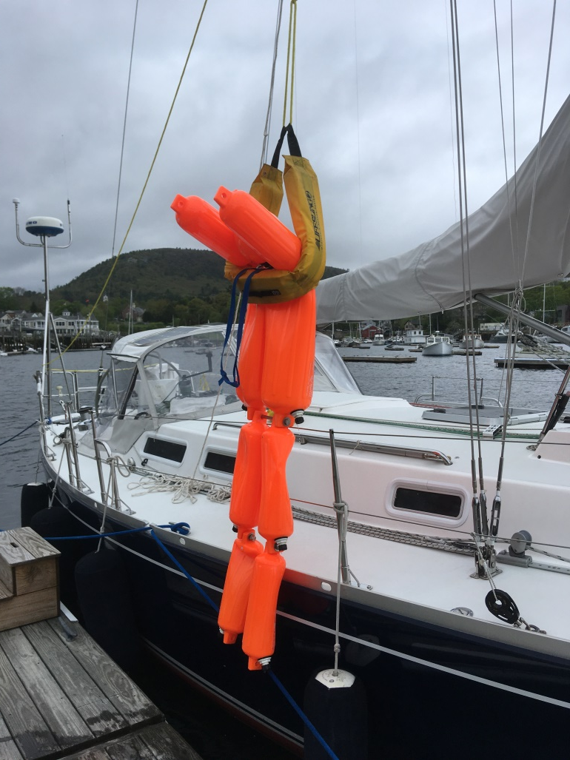

Practice On Your Own Boat
Enhanced Training
MOB Course
For
Skilled Offshore
Teams
V:120125

Slide 2
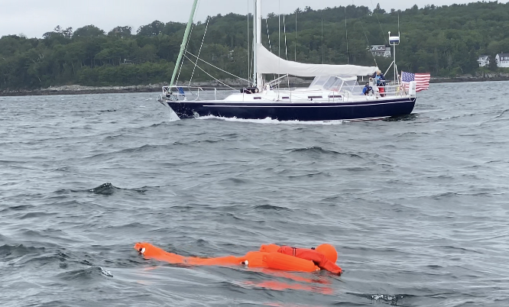
MOB Basics – Desired Outcomes
  Are you ready and prepared?
  What rescue plan (do you think) works on
  your vessel?
  Have you practiced your rescue plan?

Slide 3
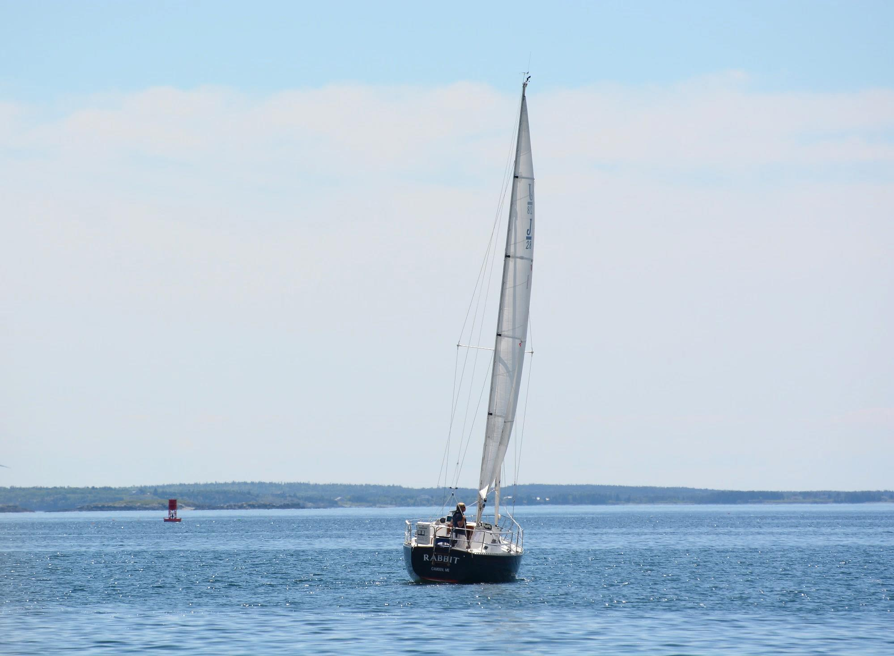
MOB Basic Rescue Principles
Don’t fall off the boat!
      Develop an onboard “Culture of Safety”
      Clear, documented onboard safety rules?
      Use personal AIS or Satellite device PAB/PLB
      Reinforce CCA Life Jacket and Tether Statement
      Stay Onboard; if not, Stay Afloat!

Slide 4
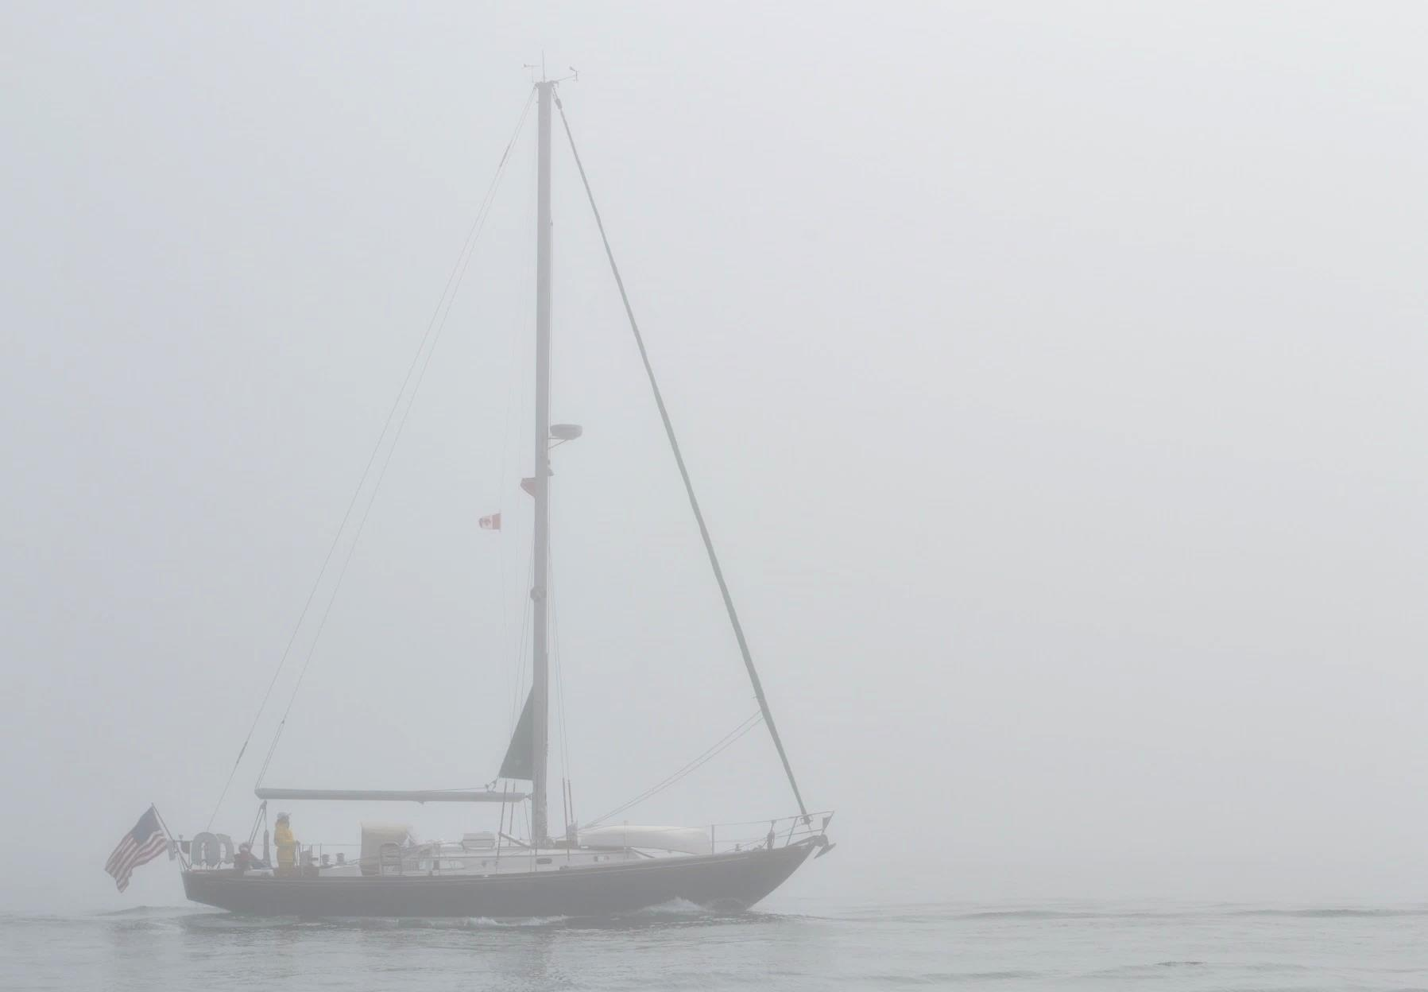
CCA Life Jacket and Tether Statement
Stay Onboard; if not, Stay Afloat!
    Wearing a life jacket and tether when on deck and underway is part of a vessel’s “Culture of Safety”
    In challenging conditions an offshore life jacket and tether become the “right tools for the job.”
    The use of tether is recommended considering”
        Sea conditions
        Low visibility conditions
        Crew limitations
        Vessel Design

Slide 5
11 Step MOB Rescue Process first 10 seconds – breathe, think, plan then act as you think: Throw/Bark/Mark/Park
    Throw
    Bark “Man Overboard”
    Mark
    Park
    Return to PIW
    Circle PIW
    Stop
    Pull PIW towards vessel
    Secure PIW to vessel
    Onboard PIW
    Medical assessment of PIW

Slide 6
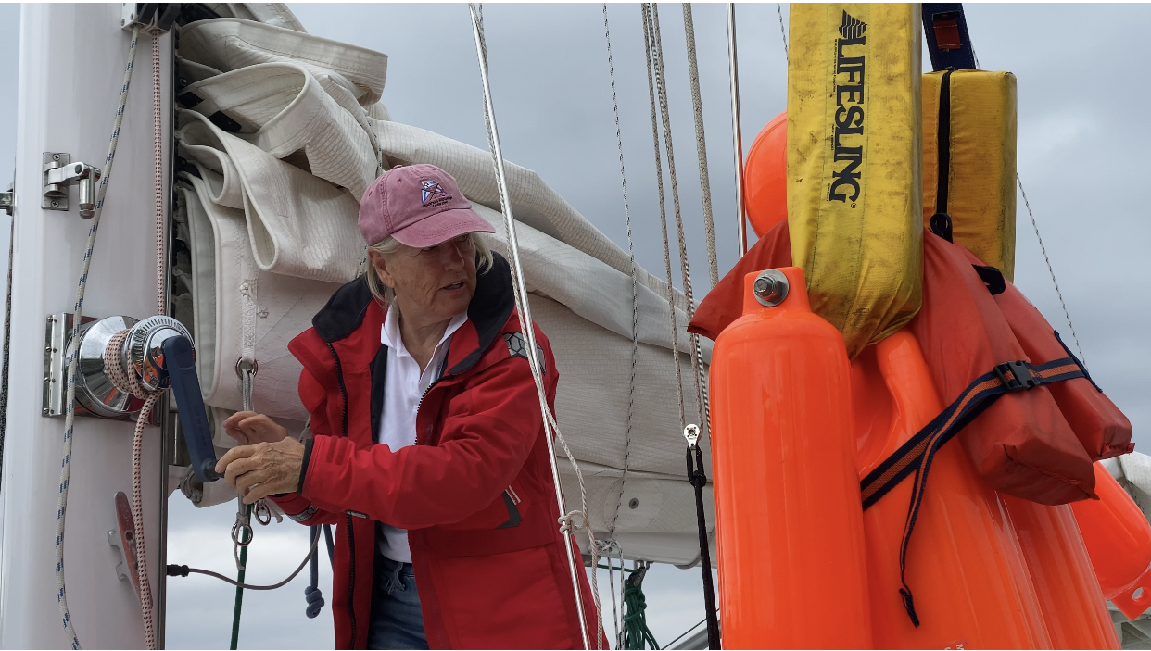
Review Onboarding Techniques
    Halyard only
    Halyard with
    tackle gear
    Mid-line Lift
What technique works best
for your boat and crew?

Slide 7
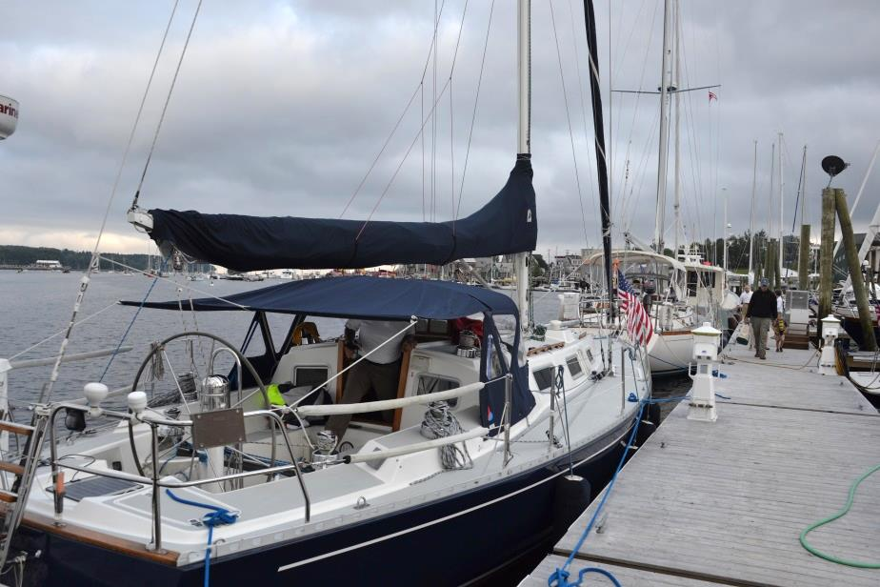

Prepare with your Crew for the
At-the-Dock Onboarding Exercise
Discuss steps to onboard a 200 pound MOB
from the dock
  LifeSling
  Your rigging and gear
Discuss:
  Which onboarding technique works best
  Running rigging selection
  Leads, winches, handles
  Attachment points
  Crew physical limits

Slide 8

Prepare with your Crew for the
On-the-Water Exercise
Identify steps needed to quickly stop the boat considering:
  Boat’s position to wind and seas
  Dropping/furling sails
  Starting the engine
Discover rigging, deck/equipment
and layout issues
Confirm use of engine and technology:
MOB electronics, VHF, video screens

Slide 9
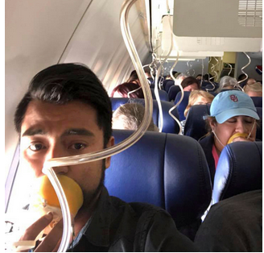
Why is the “doing” so critical?
Passengers were all “instructed”
What is wrong here?
Would they have
survived a
real emergency?
Competency involves practice - more than just listening!
Southwest Airlines Flight 1380 at 30,000 feet on April 2, 2018

Slide 10
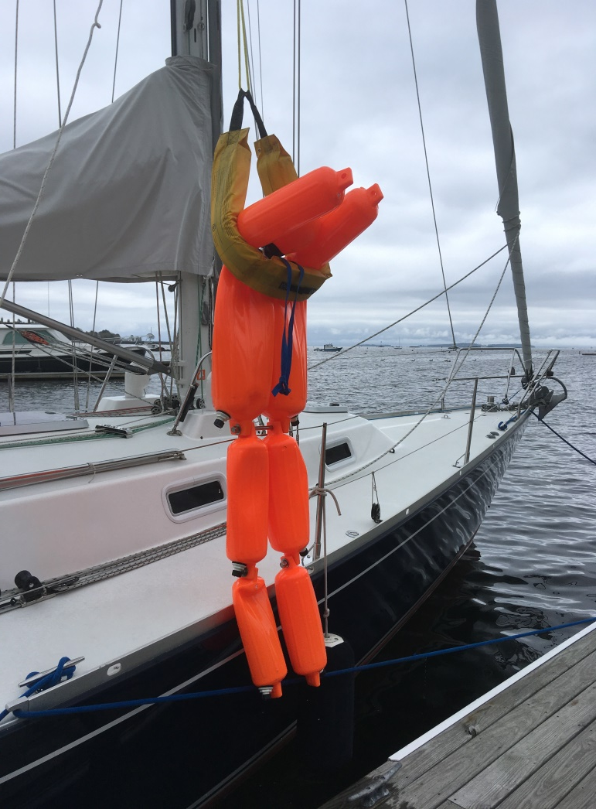

At-the-Dock Onboarding Exercise
Discuss your onboarding steps
Bring your boat to the dock or
out in calm seas
Perform a complete PIW
onboarding evolution
Testing techniques is encouraged
Review outcomes
Document your onboarding
technique
Practice a second time
FINAL

Slide 11
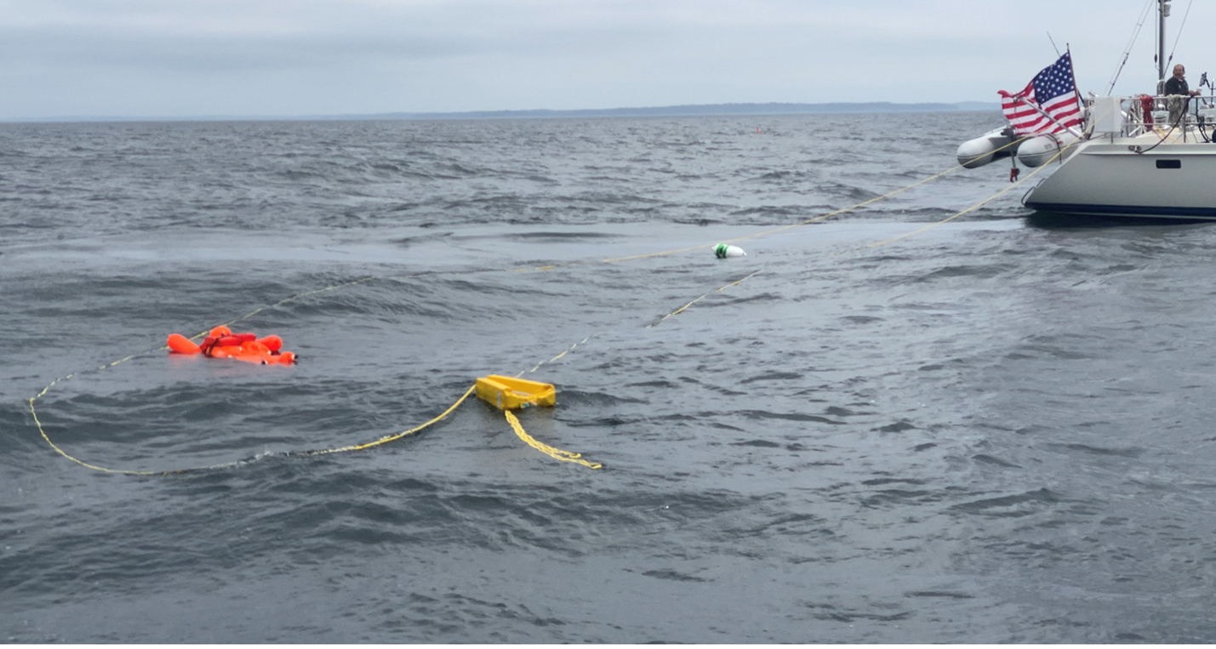

On-the Water Boat Exercise
Discuss steps with your crew
Head out on the water
Perform a MOB rescue evolution:
    Stopping the boat under full sail
    Deploying LifeSling and circle a test PIW
    Creating a MOB waypoint on plotter
Experiment as needed
Review outcomes
Record total elapse time for rescue
Document your final boat
handling steps
Practice a second time
FINAL

Slide 12
11 Step MOB Rescue Process first 10 seconds – breathe, think, plan then act as you think: Throw/Bark/Mark/Park
    Throw
    Bark “Man Overboard”
    Mark
    Park
    Return to PIW
    Circle PIW
    Stop
    Pull PIW towards vessel
    Secure PIW to vessel
    Onboard PIW
    Medical assessment of PIW

Slide 13
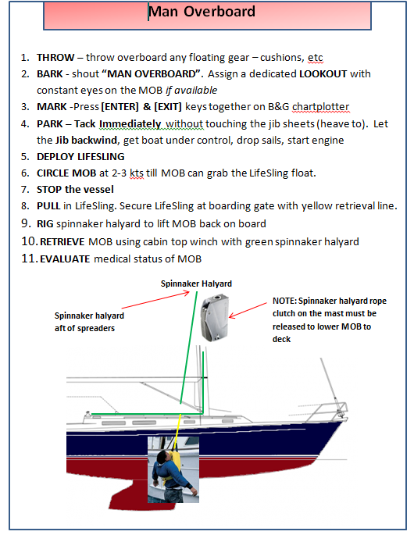
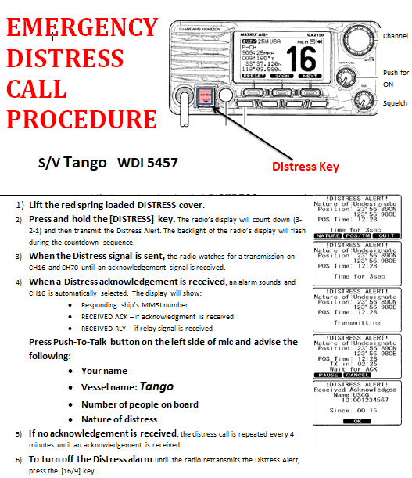
Sample VHF and
MOB Placard

Slide 14
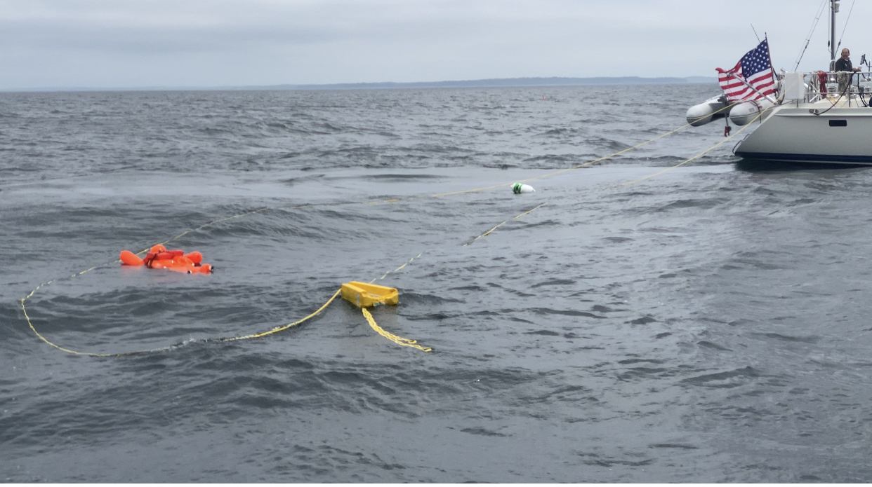
Practice On Your Own Boat
Man Overboard
Course Completion
Congratulations!

